Slide 1






Overview of McStas example instruments
MDANSE2018
So far we did not spend a lot of time on the Neutron Site menu in mcgui. Many relevant examples are available there, serving as inspiration for new users.
MDANSE 2018, Puerto de la cruz, Tenerife

Slide 2
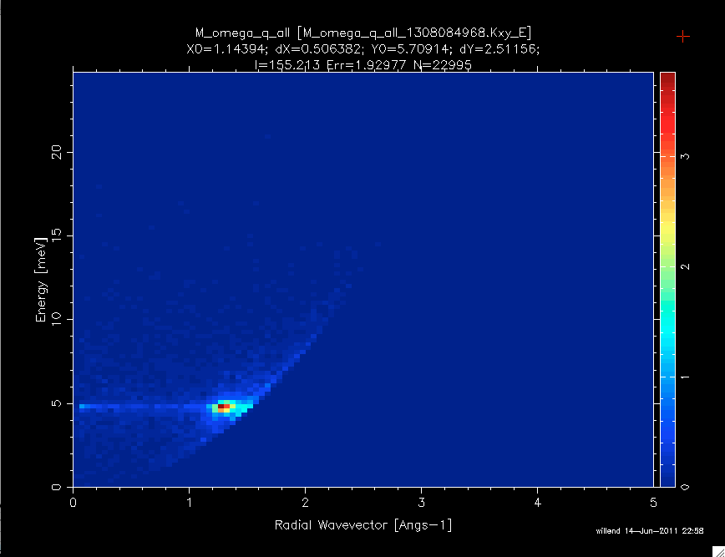
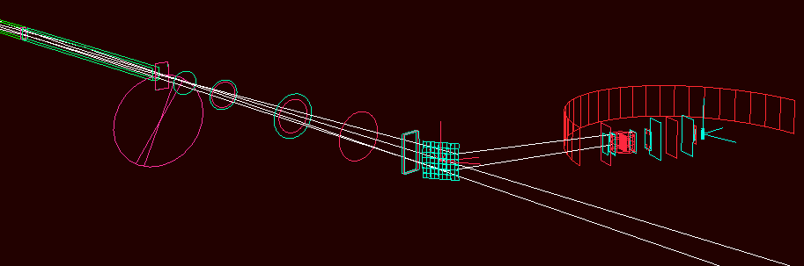
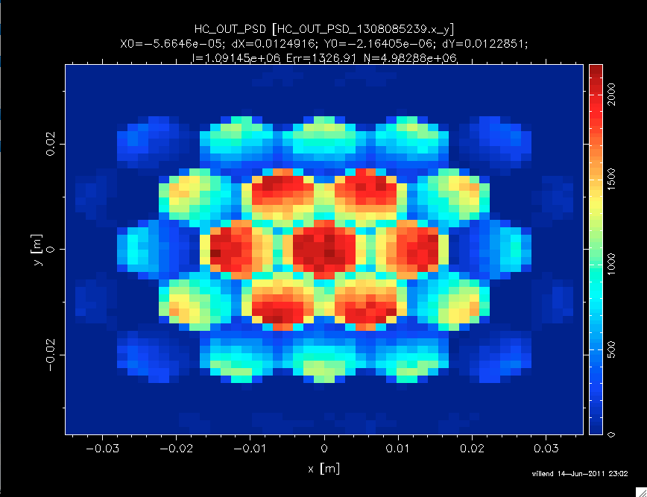
7 TOF spectrometers:
MDANSE2018
ESS_IN5_reprate.instr
ILL_BRISP.instr (Small-angle)
ILL_H15_IN6.instr
ILL_H16_IN5.instr
ISIS_Hetfull.instr
PSI_Focus.instr
templateTOF.instr
MDANSE 2018, Puerto de la cruz, Tenerife

Slide 3
7 TOF spectrometers:
MDANSE2018
ESS_IN5_reprate.instr
ILL_BRISP.instr (Small-angle)
ILL_H15_IN6.instr
ILL_H16_IN5.instr
ISIS_Hetfull.instr
PSI_Focus.instr
templateTOF.instr
Should we rename McStas to McStof ? :)
MDANSE 2018, Puerto de la cruz, Tenerife

Slide 4
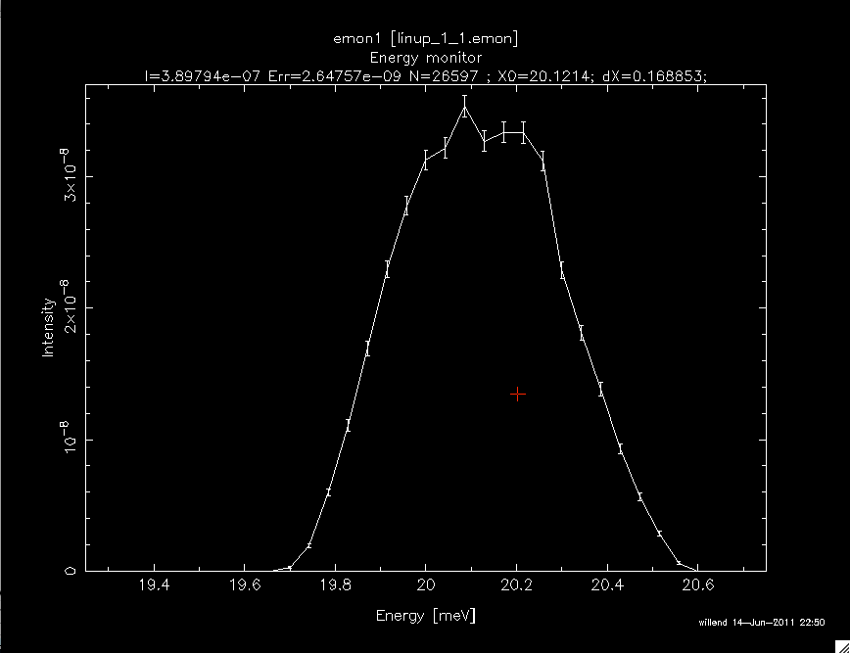
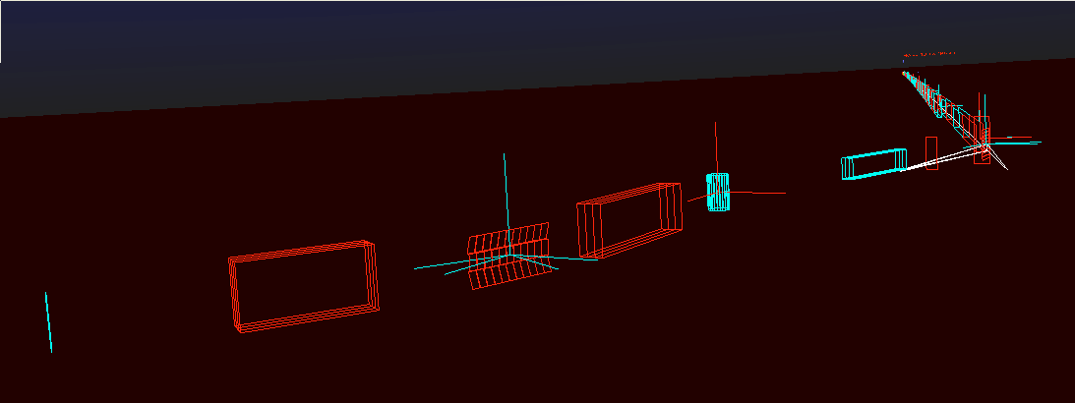
5 TAS (linup-? are all Risø TAS 1):
MDANSE2018
ILL_H142_IN12.instr
ILL_H25_IN22.instr
h8_test.instr
templateTAS.instr
linup-1.instr
linup-2.instr
linup-3.instr
linup-4.instr
linup-5.instr
linup-6.instr
linup-7.instr
MDANSE 2018, Puerto de la cruz, Tenerife

Slide 5
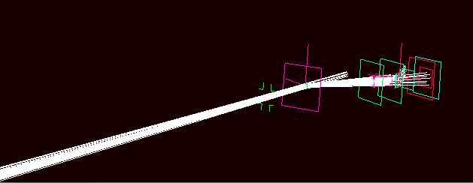
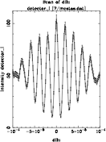
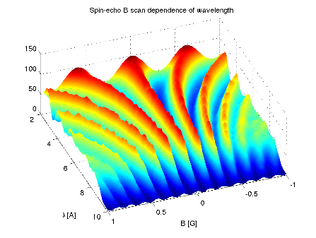
1 Hybrid spectrometer + 1 Spin-echo
MDANSE2018
1 Hybrid spectrometer:
prisma2.instr
1 Spin-echo (two different implementations, same instr):
SE_example.instr
SE_example2.instr
MDANSE 2018, Puerto de la cruz, Tenerife

Slide 6
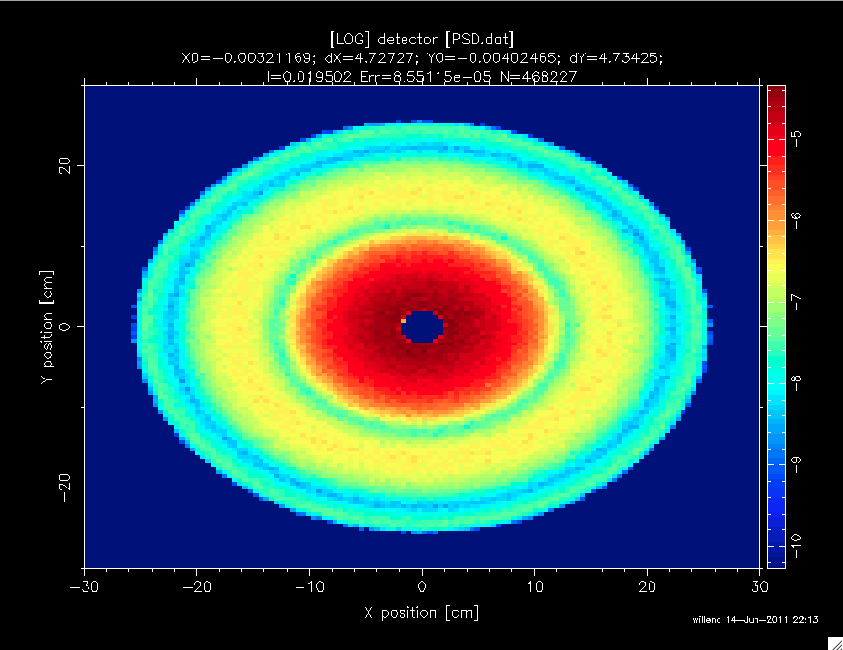
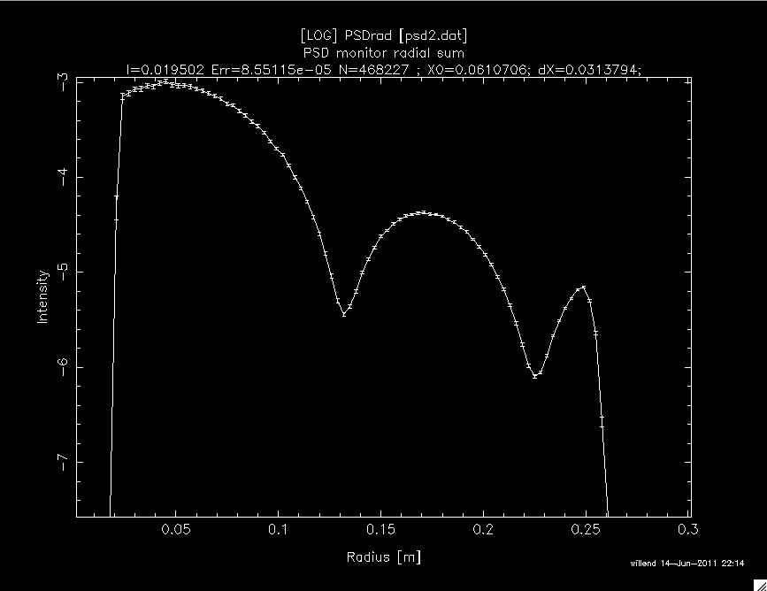
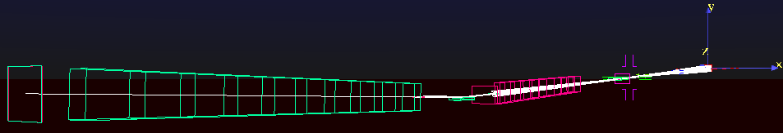
Large scale structures
MDANSE2018
2 SANS:
FZJ_KWS2_Lens.instr
FZJ_SANS_KWS2_AnySample.instr
FZJ_SANS_KWS2_DebyeS.instr
FZJ_SANS_KWS2_Guinier.instr
FZJ_SANS_KWS2_NoSample.instr
SANS.instr
1 Reflectometer:
ISIS_CRISP.instr (Not an accurate model)
MDANSE 2018, Puerto de la cruz, Tenerife

Slide 7
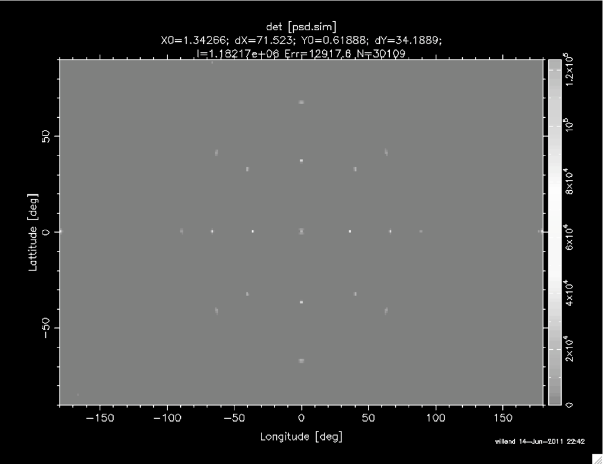
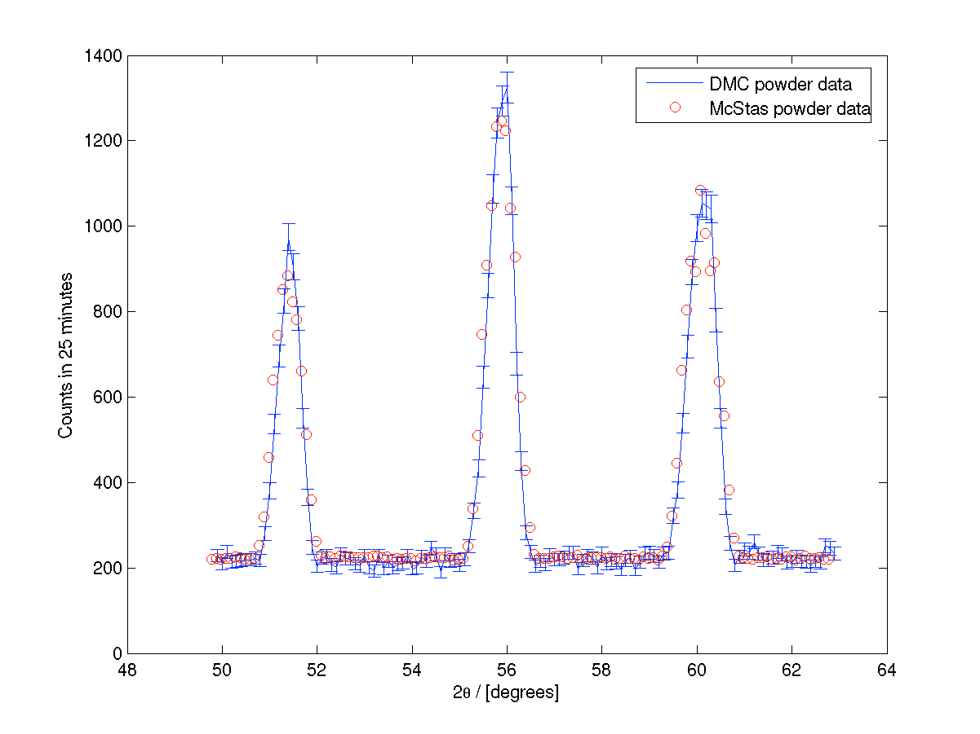
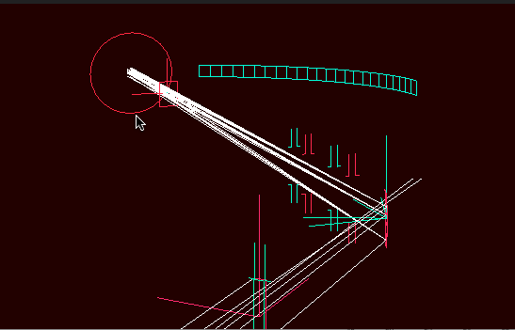
Diffractometers
MDANSE2018
ILL_D1A.instr
PSI_DMC.instr
templateDIFF.instr
templateLaue.instr
MDANSE 2018, Puerto de la cruz, Tenerife

Slide 8
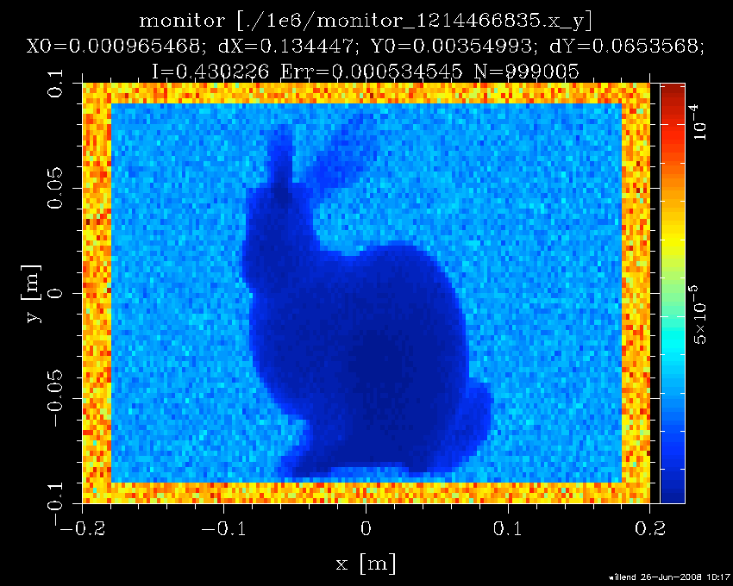
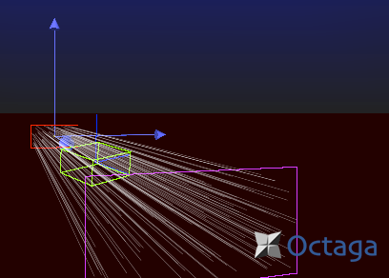
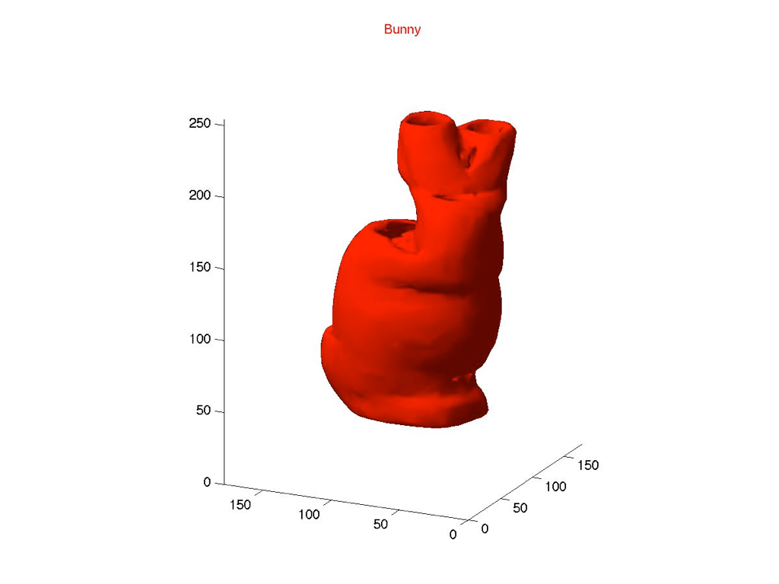
Imaging
MDANSE2018
Tomography.instr
- comes with simple
filtered backprojection
reconstruction (Matlab)
MDANSE 2018, Puerto de la cruz, Tenerife

Slide 9
Histogrammer.instr
MDANSE2018
Histogrammer.instr
- takes any kind of supported ‘event input file’, e.g. from Vitess. String parameter used as Monitor_nD options, can make all types of histograms from the event file.
(I.e. conversion tool for plotting of data)
MDANSE 2018, Puerto de la cruz, Tenerife

